Slide 1
SUPER STORE SALES DASHBOARD
Interactive Dashboard for Business Stakeholders
Prepared by: Gaurav Kumar

Slide 2
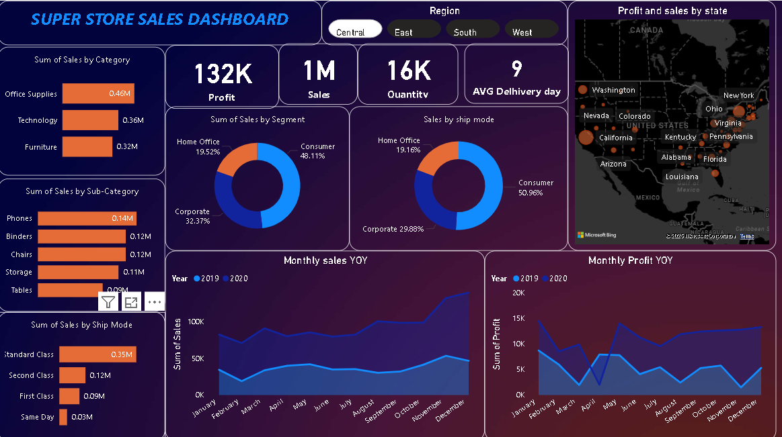
SUPER STORE SALES DASHBOARD

Slide 3
Objective & Tools Used
Objective:
To design an interactive dashboard that provides business insights on sales, profits, and forecasts across various dimensions such as category, segment, shipping mode, and region.
Tools Used:
- Power BI (Data visualization & Dashboard design)
- Excel (Data Cleaning & Preprocessing)
- Forecast Model (For sales prediction)

Slide 4
Dashboard Overview – Key Insights
Main Metrics:
- Profit: 132K
- Sales: 1M
- Quantity Sold: 16K
- Avg Delivery Days: 9 Days
High Performers:
- Top Category: Office Supplies (0.46M)
- Top Sub-Category: Phones (0.14M)
- Top Segment: Consumer (48.11%)
- Top Ship Mode: Standard Class (0.35M)
Regional Focus: Central region selected
Map Visualization: Profit & sales distribution across states like California, New York, and Texas.

Slide 5
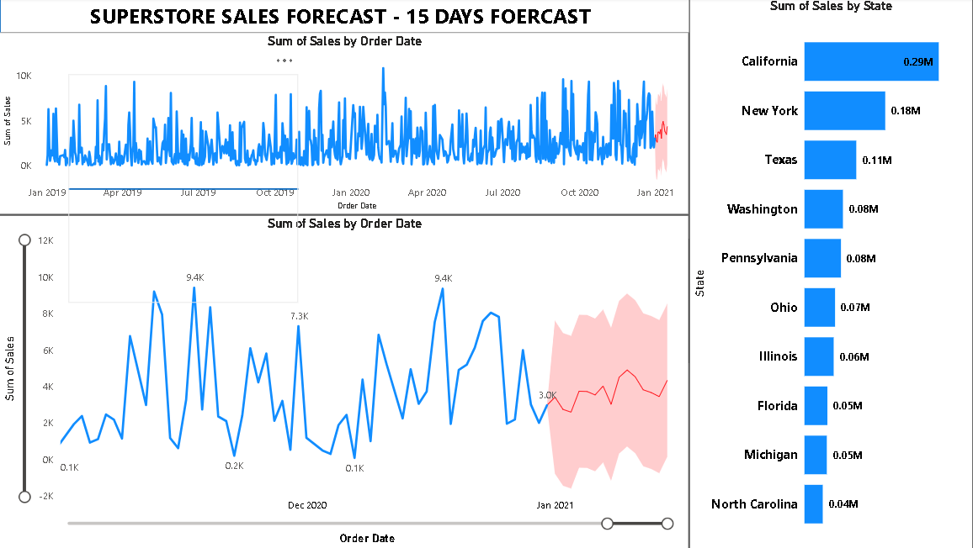
FORCASTING

Slide 6
Forecast Dashboard Summary
Forecast Horizon: Next 15 Days
Observations:
- Prediction shows consistent sales trend around 3K–4K
- Confidence Band highlights expected fluctuation
- California remains top contributor with 0.29M sales, followed by New York and Texas
Purpose:
Helps stakeholders plan for inventory, marketing campaigns, and logistics.

Slide 7
Conclusion & Business Impact
Key Outcomes:
- Delivered interactive & user-friendly dashboard
- Enabled quick decision-making through visuals
- Identified sales trends and top-performing - Forecast helps in proactive planning
- Real-time dashboard updates
- Add profit margin analysis
- Integration with sales CRM

Slide 8
Thank You!
For your time and feedback
Prepared by: Gaurav Kumar
Aspiring Data Analyst

